Slide 1
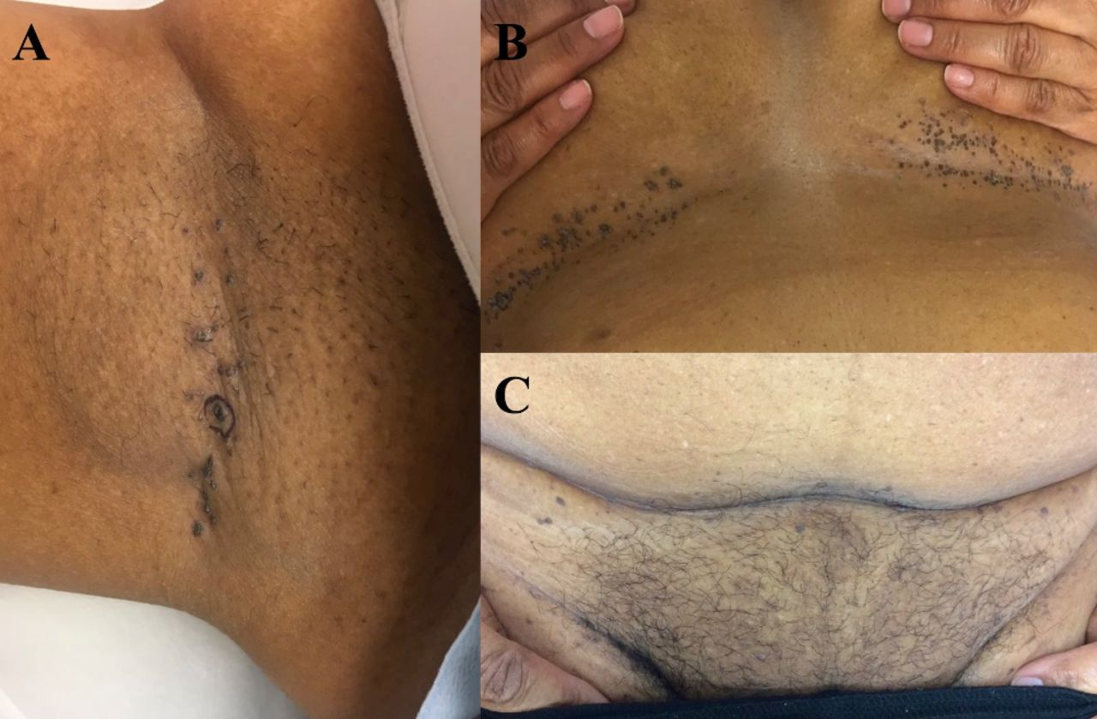

Linear hyperpigmented and hyperkeratotic papules in the (A) right axilla, (B) bilateral inframammary folds, and (C) infrapannus and inguinal folds.
Amy J Zhang et al. BMJ Case Rep 2019;12:e229604
©2019 by BMJ Publishing Group Ltd
Notes:
Linear hyperpigmented and hyperkeratotic papules in the (A) right axilla, (B) bilateral inframammary folds, and (C) infrapannus and inguinal folds.

