Slide 1
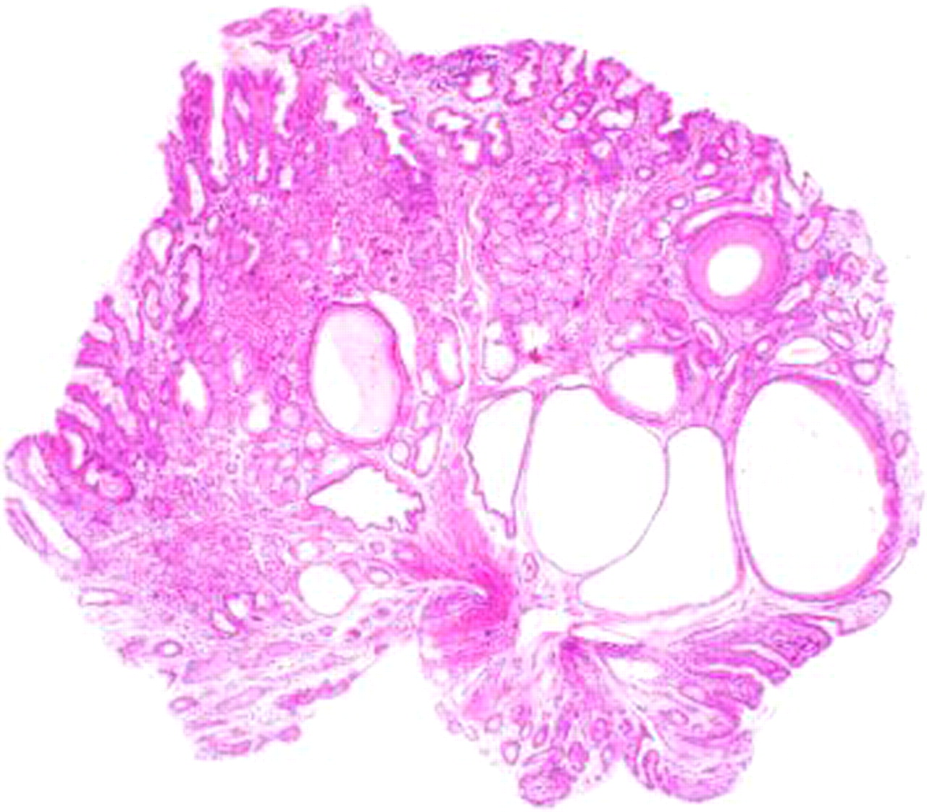

A biopsy specimen from the lesion demonstrates elongated, tortuous foveolae and hyperplastic and cystically dilated underlying pyloric glands.
Kenji Tominaga et al. BMJ Case Reports 2011;2011:bcr.08.2011.4617
©2011 by BMJ Publishing Group Ltd
Notes:
A biopsy specimen from the lesion demonstrates elongated, tortuous foveolae and hyperplastic and cystically dilated underlying pyloric glands. The lamina propria is slightly oedematous and contains a mild chronic inflammatory cellular infiltrate (H&E, original magnification x20).

